Slide 1
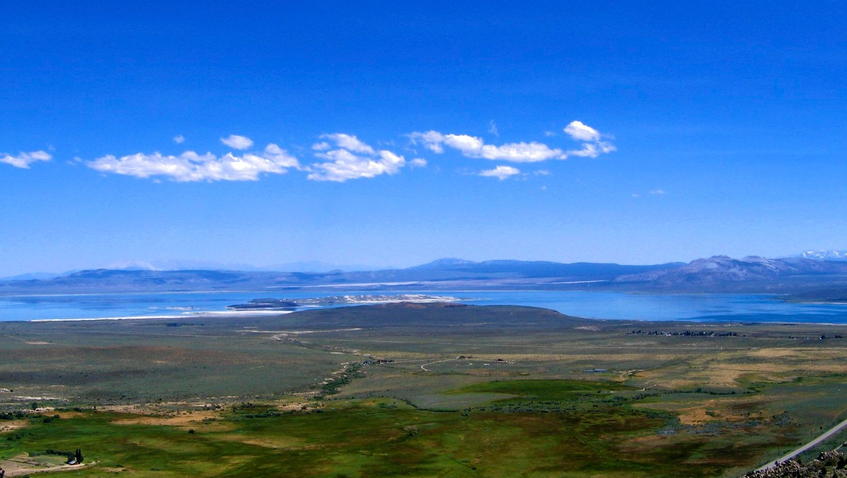
Programming your infrastructure

Slide 2

Introductions
Glen Campbell
Rackspace Hosting, Inc.

Slide 3
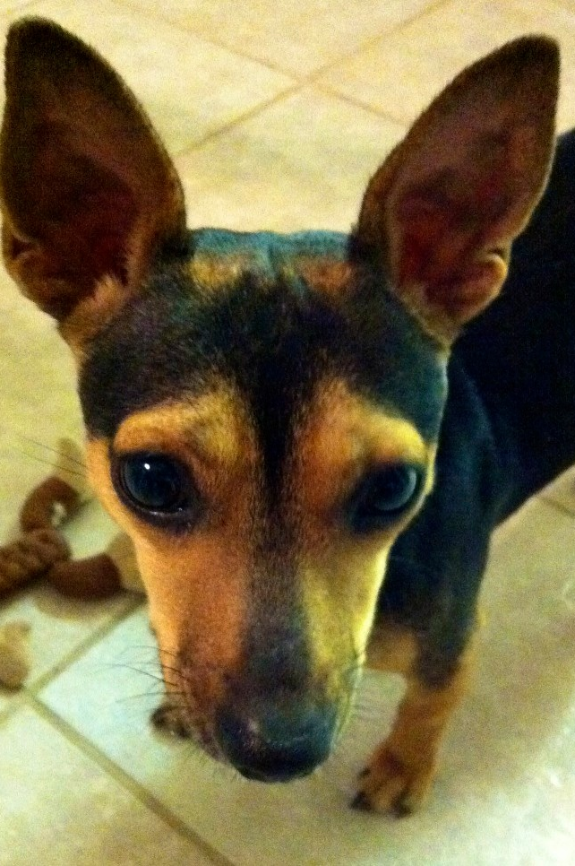
Servers as pets
We give them names
We care for them
If they get sick, we treat them
We try to maximize their lifespan
Large investment of time and energy

Slide 4
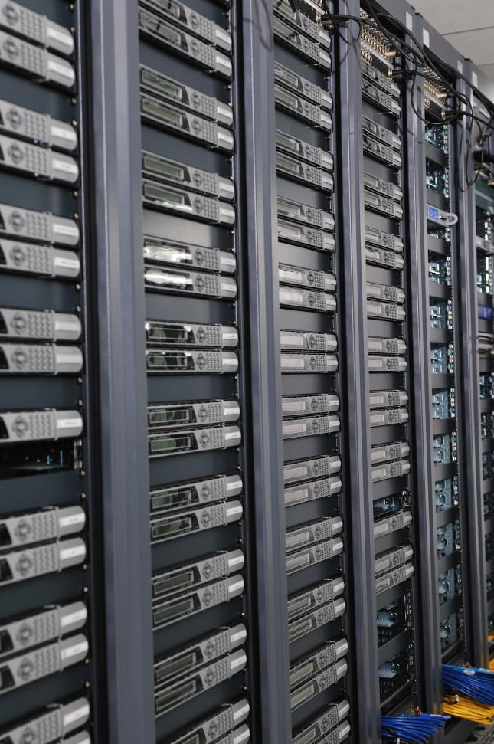
Servers as cattle
Anonymous
Tagged for specific function
Largely interchangeable
If it causes problems, we discard it and replace it
Minimal investment

Slide 5
OpenStack
Open-Source cloud management software
Compute (Nova) - server virtualization
Object Storage (Swift) - object data abstraction
Block Storage (Cinder) - virtualized disk capacity
Network (Quantum) - virtualized, ad hoc isolated networks

Slide 6
Non-openstack services
Rackspace Cloud Databases
Rackspace Cloud Load Balancers
Rackspace Cloud Monitoring
Rackspace Cloud DNS

Slide 7
Common Features
Controlled via HTTP (RESTful services)
Virtual presentation of objects and services
Anonymous deployments (with rare exceptions)

Slide 8
Why program your infrastructure?
COST - use only the server capacity you need
Adjust capacity to meet variable demand
Create capacity for special functions
Eliminate manual errors by building repeatable processes

Slide 9
Use case: New Engineer
Script to build virtual servers on-demand
Engineer builds servers as needed, and destroys them at the end of the day
Don’t pay to “keep the lights on” for servers that aren’t in use
If she needs a specific operating system, or multiple versions, those are easily accessible

Slide 10
USE CASE: Special Events
Your product is being featured on the “Today Show”
Your company expects 50x the normal traffic
Virtual servers handle the expected demand, then easily discarded once the traffic drops

Slide 11
Demonstration
(cross your fingers)

